Slide 1
Identification of the authors of short messages portals on the Internet using the methods of mathematical linguistics.
"St. Petersburg National Research University of Information Technologies, Mechanics and Optics"
Department of "Secure Information Technology"
Specialty 05.13.19
"Methods and systems of information protection, information security"
Postgraduate: | Sukhoparov M.E.
Supervisor: | doctor of engineering science, Lebedev I.S.

Slide 2
Purpose and objectives
The goal - a study of methods to identificate users.
Objectives:
study and development of scientific-methodical system of identification of authorship of textual information
creation of the program layout, based on the proposed approach
assessment of the performance and efficiency of the developed prototyping implementation

Slide 3

The wording of solving scientific problems
Find a variety
$M :Q→ Q^{′} , D → D^{′}, ∀q^{′}\left(q^{′}∈Q^{′}\right),∀d^{′}\left(d^{′}∈D^{′}\right)$, such as
$∃(\hat{I}=\hat{I}\{M,H,q,q^{′},{d,d}^{′},∆I\})$, where
$$\left|I−\hat{I}\right|⇒∆I_{min}, M :T\underset{→}{F}O$$

Slide 4
Prospective directions of research
The use of naive Bayes classifier
Analysis based on the N - grams
Analysis based on latent Dirichlet allocation

Slide 5
Architecture of the proposed software
1
Topic
Users
1
*
Posts
*
*
Words
*
Vocabulary
Filters
Words in Posts

Slide 6
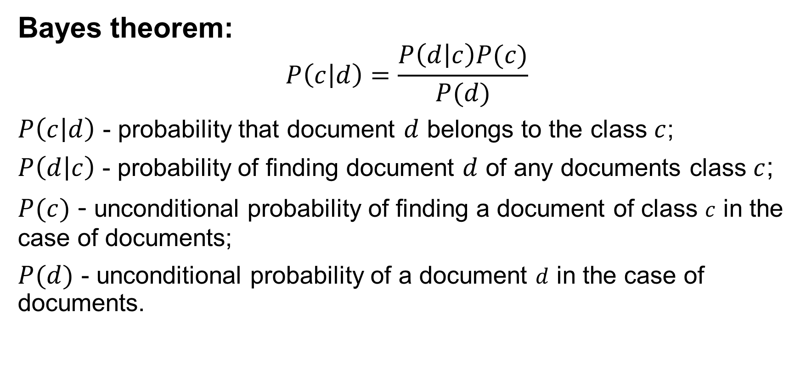
Naive Bayes classifier
Bayes theorem:
$$P\left(c | d\right)=\frac{P\left(d | c\right)P(c)}{P(d)}$$
$P\left(c | d\right)$ - probability that document $d$ belongs to the class $c$;
$P\left(d | c\right)$ - probability of finding document $d$ of any documents class $c$;
$P(c)$ - unconditional probability of finding a document of class $c$ in the case of documents;
$P(d)$ - unconditional probability of a document $d$ in the case of documents.

Slide 7
Naive Bayes classifier
Maximum a posteriori estimation:
$$c_{map}=\underset{c∈C}{argmax}{\frac{P\left(d | c\right)P(c)}{P(d)}}$$
$$P\left(d | c\right)≈P\left(ω_{1} | c\right)P\left(ω_{2} | c\right)…P\left(ω_{n} | c\right)≈\prod_{i}^{n}{P(ω_{i}|c)}$$
$$c_{map}=\underset{c∈C}{argmax}\left[P(c)\prod_{i}^{n}{P(ω_{i}|c)}\right]$$

Slide 8
Naive Bayes classifier
The problem of arithmetic overflow:
$$c_{map}=\underset{c∈C}{argmax}\left[\log{P(c)}+\sum_{i}^{n}{\log{P(ω_{i}|c)}}\right]$$
Estimation of parameters of the Bayes model:
$P\left(c\right)=\frac{D_{c}}{D}$, where $D_{c}$ - number of documents belong to class $c$, $D$ - total number of documents in the training set;
$P\left(ω_{i} | c\right)=\frac{W_{ic}}{\sum_{i^{′}∈V}{W_{i^{′}c}}}$, where $W_{ic}$ - number of times as the i-th word appears in the documents of class $c$, $V$ - dictionary of a set of documents (a list of all unique words).

Slide 9
Naive Bayes classifier
The problem of unknown words:
$$P\left(ω_{i} | c\right)=\frac{W_{ic}+1}{\sum_{i^{′}∈V}{{(W}_{i^{′}c}+1)}}=\frac{W_{ic}+1}{\left|V\right|+\sum_{i^{′}∈V}{W_{i^{′}c}}}$$
The final view of the formula:
$$c_{map}=\underset{c∈C}{argmax}\left[\log{\frac{D_{c}}{D}}+\sum_{i}^{n}{\log{\frac{W_{ic}+1}{\left|V\right|+\sum_{i^{′}∈V}{W_{i^{′}c}}}}}\right]$$

Slide 10
Naive Bayes classifier
Statistics used in the classification stage:
relative frequencies of the classes in the case of documents;
total number of words in each document class;
the relative frequencies of words within each class;
dictionary size (amount of unique words in training set).
$$\log{\frac{D_{c}}{D}}+\sum_{iεQ}^{n}{\log{\frac{W_{ic}+1}{\left|V\right|+L_{c}}}}$$
$D_{c}$ - number of documents belong to class $c;$
$D$ - total number of documents in the training set;
$V$ - dictionary of a set of documents (a list of all unique words);
$L_{c}$- the total number of words in documents of class c in the training set;
$W_{ic}$ - number of times as the i-th word appears in the documents of class $c$;
$Q$ - set of words of classified document (including repeats).

Slide 11
Results
$$P\left(c | d\right)$$

Slide 12
Conclusions
The implementation of the proposed solutions will identify the authors of short message forums and blogs on the Internet at various PR - actions to combat and control the formation and manipulation of public opinion and other manifestations of astroterfing.

